Slide 1
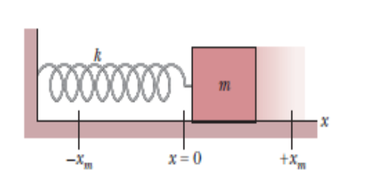
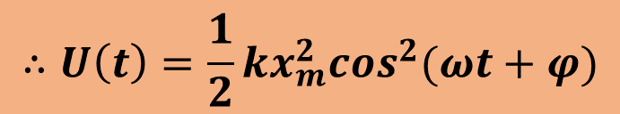
Energy in SHM
We consider a linear simple harmonic oscillator.
The potential energy of a linear oscillator is associated entirely with the spring. Its value depends on how much the spring is stretched or compressed that is, on x(t).
The potential energy is, $U\left(t\right)=\frac{1}{2} kx^{2}$
$$∴U\left(t\right)=\frac{1}{2}kx_{m}^{2}\cos^{2}(ωt+φ)$$

Slide 2
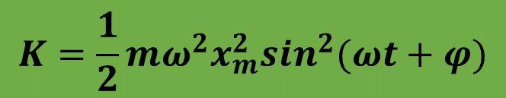

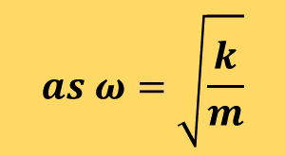
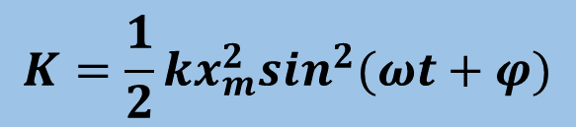
The kinetic energy of the oscillator is associated entirely with the block. Its value depends on how fast the block is moving—that is, on v(t).
The Kinetic energy of the system,
$K=\frac{1}{2}mv^{2}$
$$K=\frac{1}{2}mω^{2}x_{m}^{2}\sin^{2}(ωt+φ)$$
$$K=\frac{1}{2}kx_{m}^{2}\sin^{2}(ωt+φ)$$
$$as ω=\sqrt{\frac{k}{m}}$$

Slide 3
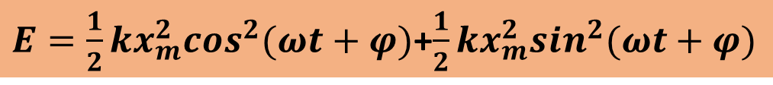

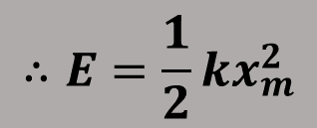
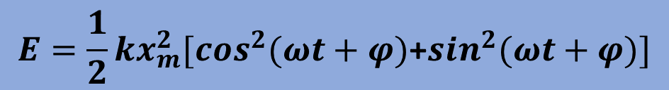
Now the mechanical energy of the system,
$$E=U+K$$
$E=\frac{1}{2}kx_{m}^{2}\cos^{2}(ωt+φ)$+$\frac{1}{2}kx_{m}^{2}\sin^{2}(ωt+φ)$
$$E=\frac{1}{2}kx_{m}^{2}{[cos}^{2}(ωt+φ)\text{+}\sin^{2}(ωt+φ)]$$
$$∴E=\frac{1}{2}kx_{m}^{2}$$
Thus the mechanical energy of a linear oscillator is constant and independent of time.

Slide 4
Potential energy and Kinetic energy as a function of time
Note that all energies are positive and that the potential energy and the kinetic energy peak twice during every period.
Potential energy and Kinetic energy as a function of displacement
For x = 0 the energy is all kinetic, and for x = x_{m} it is all potential.

Slide 5

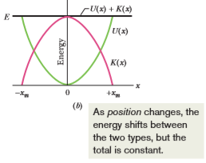
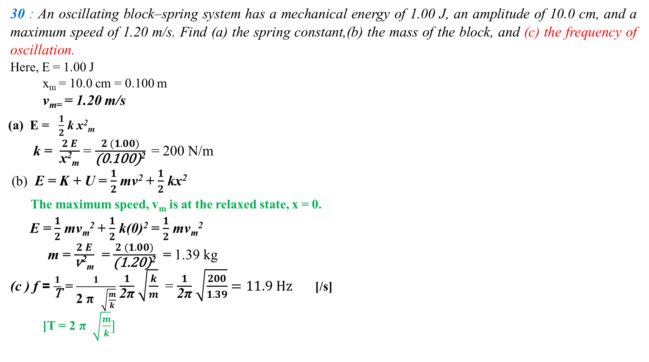
30 : An oscillating block–spring system has a mechanical energy of 1.00 J, an amplitude of 10.0 cm, and a maximum speed of 1.20 m/s. Find (a) the spring constant,(b) the mass of the block, and (c) the frequency of oscillation.
Here, E = 1.00 J
x_{m} = 10.0 cm = 0.100 m
v_{m=} = 1.20 m/s
(a) E = $\frac{1}{2}$ k x²_{m}
k = $\frac{ 2 E }{\text{x}\text{2}\text{m}}$ = $\frac{ 2 (1.00) }{\text{(0.100)}\text{2}}$ = 200 N/m
(b) E = K + U = $\frac{1}{2}$ mv² + $\frac{1}{2}$ kx²
The maximum speed, v_{m} is at the relaxed state, x = 0.
E = $\frac{1}{2}$ mv_{m}² + $\frac{1}{2}$ k(0)² = $\frac{1}{2}$ mv_{m}²
m = $\frac{ 2 E }{\text{v}\text{2}\text{m}}$ = $\frac{ 2 (1.00) }{\text{(1.20)}\text{2}}$ = 1.39 kg
(c ) f = $\frac{1}{\text{T}}$ = $\frac{1}{\text{2} \text{π} \sqrt{\frac{m}{k}}}$ $\frac{ 1 }{\text{2}\text{π}}$ $\sqrt{\frac{k}{m}}$ = $\frac{ 1 }{\text{2}\text{π}}$ $\sqrt{\frac{200}{1.39}}=11.9 Hz$ [/s]
[T = $\text{2} \text{π}$ $\sqrt{\frac{m}{k}}]$

Slide 6
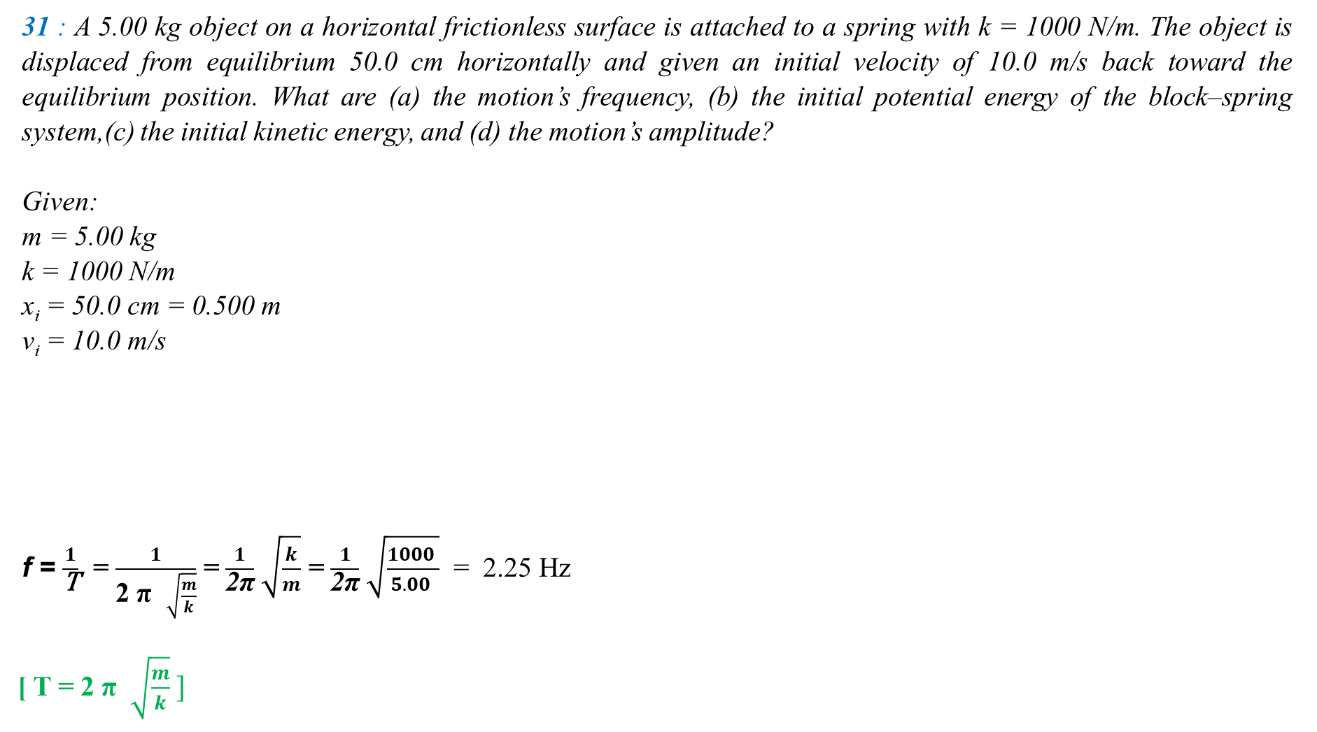
31 : A 5.00 kg object on a horizontal frictionless surface is attached to a spring with k = 1000 N/m. The object is displaced from equilibrium 50.0 cm horizontally and given an initial velocity of 10.0 m/s back toward the equilibrium position. What are (a) the motion’s frequency, (b) the initial potential energy of the block–spring system,(c) the initial kinetic energy, and (d) the motion’s amplitude?
Given:
m = 5.00 kg
k = 1000 N/m
x_{i} = 50.0 cm = 0.500 m
v_{i} = 10.0 m/s
f = $\frac{1}{\text{T}}$ = $\frac{1}{\text{2} \text{π} \sqrt{\frac{m}{k}}}$ = $\frac{ 1 }{\text{2}\text{π}}$ $\sqrt{\frac{k}{m}}$ = $\frac{ 1 }{\text{2}\text{π}}$ $\sqrt{\frac{1000 }{5.00 }}$ = 2.25 Hz
[ T = $\text{2} \text{π}$ $\sqrt{\frac{m}{k}} ]$
x_{m} = 86.6 cm
x_{i} = 50 cm
v_{i} = 10.0 m/s

Slide 7
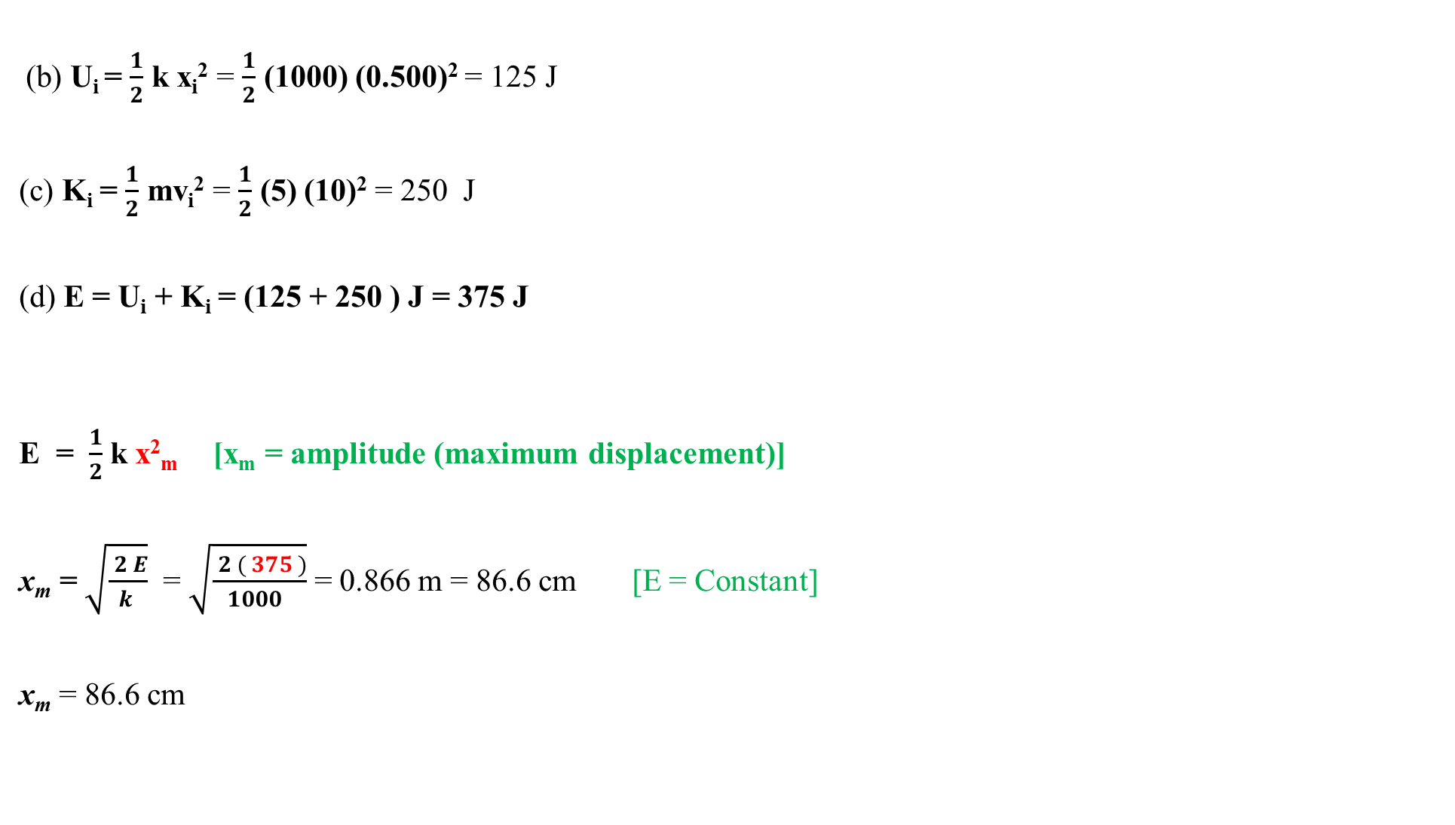

x_{i} = 50 cm
(b) U_{i} = $\frac{1}{2}$ k x_{i}² = $\frac{1}{2}$ (1000) (0.500)² = 125 J
(c) K_{i} = $\frac{1}{2}$ mv_{i}² = $\frac{1}{2}$ (5) (10)² = 250 J
(d) E = U_{i} + K_{i} = (125 + 250 ) J = 375 J
E = $\frac{1}{2}$ k x²_{m} [x_{m} = amplitude (maximum displacement)]
x_{m} = $\sqrt{\frac{ 2 E}{k }}$ = $\sqrt{\frac{ 2 ( 375 )}{1000 }}$ = 0.866 m = 86.6 cm [E = Constant]
x_{m} = 86.6 cm
v_{i} = 10.0 m/s
E = = $\frac{1}{2}$ k x²_{m} + $\frac{1}{2}$ mv_{m}² = $\frac{1}{2}$ k x²_{m} + $\frac{1}{2}$ m(0)²

Slide 8
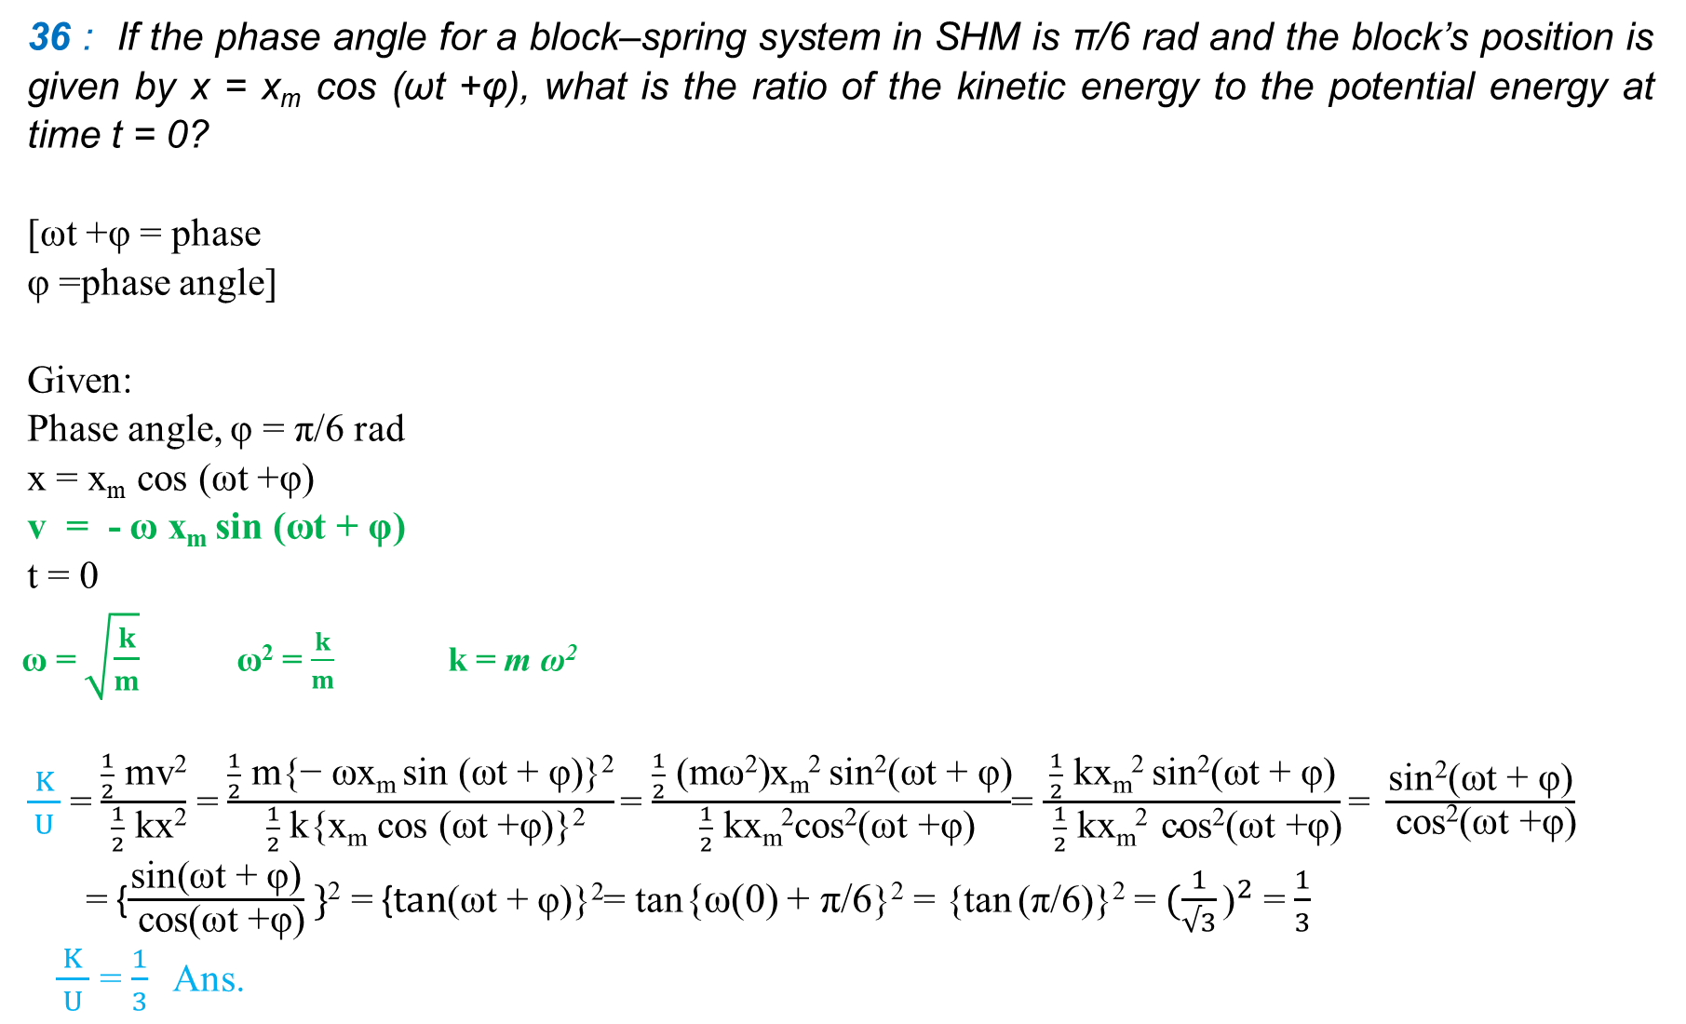
36 : If the phase angle for a block–spring system in SHM is π/6 rad and the block’s position is given by x = x_{m} cos (ωt +φ), what is the ratio of the kinetic energy to the potential energy at time t = 0?
[ωt +φ = phase
φ =phase angle]
Given:
Phase angle, φ = π/6 rad
x = x_{m} cos (ωt +φ)
v = - ω x_{m} sin (ωt + φ)
t = 0
ω = $\sqrt{\frac{k}{m}}$ ω² = $\frac{k}{m}$ k = m ω²
$\frac{ K }{ U }$ = $\frac{\frac{1}{2} \text{mv}\text{2}}{ \frac{1}{2} \text{kx}\text{2}}$ = $\frac{\frac{1}{2} \text{m}\text{\{}\text{− }\text{ωxm} \text{sin}\text{ (}\text{ωt}\text{ + }\text{φ}\text{)\}2}}{ \frac{1}{2} \text{k}\text{\{}\text{x}\text{m} \text{cos}\text{ (}\text{ωt}\text{ +}\text{φ}\text{)\}2}}$= $\frac{\frac{1}{2} \text{(}\text{mω}\text{2}\text{)}\text{x}\text{m}\text{2} \text{sin}\text{2}\text{(}\text{ωt}\text{ + }\text{φ}\text{)}}{ \frac{1}{2} \text{kxm}\text{2}\text{cos}\text{2}\text{(}\text{ωt}\text{ +}\text{φ}\text{)}}$= $\frac{\frac{1}{2} \text{k}\text{x}\text{m}\text{2} \text{sin}\text{2}\text{(}\text{ωt}\text{ + }\text{φ}\text{)}}{ \frac{1}{2} \text{kxm}\text{2} \text{c}\text{os}\text{2}\text{(}\text{ωt}\text{ +}\text{φ}\text{)}}\text{= }\frac{\text{sin}\text{2}\text{(}\text{ωt}\text{ + }\text{φ}\text{)}}{ \text{cos}\text{2}\text{(}\text{ωt}\text{ +}\text{φ}\text{)}}$
= {$\frac{\text{sin}\text{(}\text{ωt}\text{ + }\text{φ}\text{)}}{ \text{cos}\text{(}\text{ωt}\text{ +}\text{φ}\text{)}} \}$² = {$\text{t}\text{an}\text{(}\text{ωt}\text{ + }\text{φ}\text{)\}2}$= tan{ω(0) + π/6}² = {tan (π/6)}² =${ (\frac{1}{√3}\text{)}}^{2}$= $\frac{1}{3}$
$\frac{ K }{ U }$ = $\frac{1}{3}$ Ans.

Slide 9
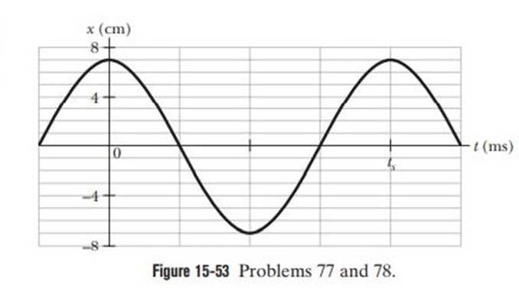
Home Work
77: Figure 15-53 gives the position of a 20 g block oscillating in SHM on the end of a spring. The horizontal axis scale is set by t_{s} = 40.0 ms. What are (a) the maximum kinetic energy of the block and (b) the number of times per second that maximum is reached? (Hint: Measuring a slope will probably not be very accurate. Find another approach)

Slide 10
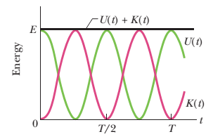

_{m = 20 gm = 0.020 kg}
x_{m}= 7 cm = 0.07 m
_{T = 40 ms = 0.040 s}
x(t) = x_{m} cos($ωt + φ$)
v(t) = $\frac{dx}{dt}$ = $\frac{d}{dt}$ {x_{m} sin($ωt + φ$)}
= - ω x_{m} sin($ωt + φ$ )
v_{m} = ωx_{m}
$ω$ = $\frac{2π}{T}$ = $\frac{2π}{0.040}$ = 157.08 rad/s
$K_{max}=\frac{1}{2}mv_{m}^{2}$ = $\frac{1}{2}m$(${{ωx}_{m})}^{2}$= $\frac{1}{2}mω^{2}x_{m}^{2}$
= $\frac{1}{2}(0.020){(157.08)}^{2}$(${0.07)}^{2}$
= 1.20 J
(b) $f$ = $\frac{1}{T}$ = $\frac{1}{0.40}$ = 25 Hz or [25 cycles per s]
From figures:
v_{m}
v_{m}
K_{max}
K_{max}
1 cycles per second , the maximum KE is reached 2 times
25 cycles per second ,the maximum KE is reached 2x25 times or 50 times

